Slide 1
Testing Concepts for Developers
Notes:
The early development of the test plan, during the analysis or design stage, ensures that the specifications being developed are testable and that the people who best understand the specifications of the product define complete and comprehensive test conditions

Slide 2
Types of Testing
Principles of Testing
1 Principles
2 Testing Type
3 Static testing
4 Dynamic test
techniques
5 Automation
6 Tools
Notes:
The early development of the test plan, during the analysis or design stage, ensures that the specifications being developed are testable and that the people who best understand the specifications of the product define complete and comprehensive test conditions

Slide 3
Principles of Testing
Contents
Testing and Quality Assurance
V- Model
Verification / Validation
Prioritization
Fundamental Test Process
1
2
3
4
5
6
Notes:
The early development of the test plan, during the analysis or design stage, ensures that the specifications being developed are testable and that the people who best understand the specifications of the product define complete and comprehensive test conditions

Slide 4
Testing
“Testing should intentionally attempt to make things go wrong to determine if things happen when they shouldn't or things don't happen when they should.
It is oriented to 'detection'.”
Notes:
The early development of the test plan, during the analysis or design stage, ensures that the specifications being developed are testable and that the people who best understand the specifications of the product define complete and comprehensive test conditions

Slide 5
Testing Principles
All tests should be traceable to customer requirements
Tests should be planned long before testing
Testing should begin in “small” and progress towards testing “in large”
Exhaustive testing is not possible

Slide 6
Quality Assurance
“Software QA involves the entire software development PROCESS – monitoring and improving the process, making sure that any agreed- upon standards and procedures are followed, and ensuring that problems are found and dealt with.
It is oriented to ‘prevention’ ”
Notes:
The early development of the test plan, during the analysis or design stage, ensures that the specifications being developed are testable and that the people who best understand the specifications of the product define complete and comprehensive test conditions

Slide 7
V-Model Testing Methodology
Verification is done within each component before moving to the next component in the model.
Demonstrates Validation of the work done at the previous component..
Demonstrates Verification of related components during testing.
Production Ops
Operational
Readiness
Test
Test
Requirements
Verify
User
Acceptance
Test
Functional
Technical
Product Test
Product Test
Team
Application
Integration
Performance Test
Validate
Design
Assembly
Test
Detailed
Design &
Build
Component
Test
Development

Slide 8
V-Model
V- Model provides a structured testing framework to guide work throughout the development process.
Designed to support the achievement of stage containment by organizing the verification, validation in and across all of the methodology elements throughout the Delivering phase of the methodology.
Notes:
The early development of the test plan, during the analysis or design stage, ensures that the specifications being developed are testable and that the people who best understand the specifications of the product define complete and comprehensive test conditions

Slide 9
Guiding Principles
The V-model framework is based upon the
following Guiding principles:
Stage Containment
Verification & Validation
Entry and Exit Criteria
Notes:
The early development of the test plan, during the analysis or design stage, ensures that the specifications being developed are testable and that the people who best understand the specifications of the product define complete and comprehensive test conditions

Slide 10
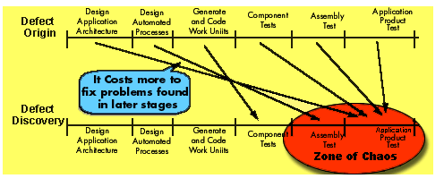
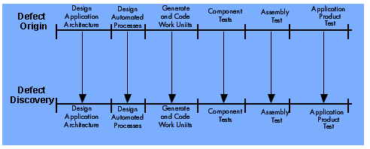
Stage Containment
Identify problems at each stage in a product’s development, before the problems can be passed on to the next stage
Minimize Problems and Maximize efficiency
Notes:
The early development of the test plan, during the analysis or design stage, ensures that the specifications being developed are testable and that the people who best understand the specifications of the product define complete and comprehensive test conditions

Slide 11
V-Model Terminologies
Validation. Doing the right thing:
  Checks that output deliverables satisfy the requirements specified in a previous stage’s input deliverables. (Traceability)
  Ensures that the work product is in scope, contributes to the intended benefits, and does not have undesirable side effects.
  Is performed by inspecting, simulating, or prototyping.
Verification. Doing it the right way:
  Checks that a deliverable is correctly derived and internally consistent.
  Checks that output and the process conform to the standards.
  Is performed by inspecting and reviewing.
Testing. Right things working right:
  Checks that a specification is properly implemented.
  Is performed by executing the code.

Slide 12
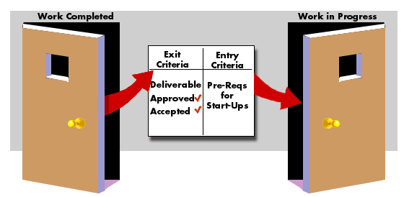
Entry and Exit Criteria
Entry and exit criteria are predefined criteria that deliverables must meet before exiting one stage and entering another
Notes:
The early development of the test plan, during the analysis or design stage, ensures that the specifications being developed are testable and that the people who best understand the specifications of the product define complete and comprehensive test conditions

Slide 13
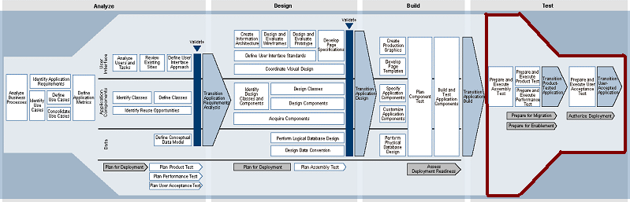
Where am I?
Analyze → Design → Build →Test

Slide 14
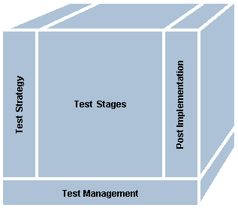
Testing Framework (1/3)
The Test Strategy defines the major aspects of the test effort and outlines the coverage to key sponsors. This ensures that testing is considered from the outset of a project, reducing the risk of failure.
Testing a business system is a complex undertaking. To manage the complexity, testing is divided into a number of standard stages, based on the V-Model concept. Standard test stages ensure that each component of a solution, the assembly of components, and the overall solution meet established functional and technical requirements.
The Testing Framework requires that test management be carried out concurrently with all core testing activities. This ensures that every test effort is effectively planned, monitored, and organized and that core framework activities are completed in a structured, consistent, and efficient manner.

Slide 15
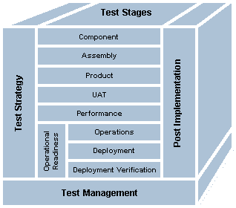
Testing Framework (2/3)
Component test. Sometimes called unit test, this tests the individual units of an entire solution. The test ensures that the component (or module) is built and behaves as detailed in the specifications. Component testing is the lowest level of testing.
Assembly test. Sometimes called string test, this tests the assembly and combined operation of related components. It ensures that the interactions between the components function correctly.
Product test. Sometimes called system test, this tests that all functional and business requirements have been met by the system. It can be broken down into two separate tests for systems that involve multiple applications (for example, enterprise integration):
User Acceptance Test (UAT). Ensures that the users and stakeholders are satisfied with the solution. Only after this test is complete can the product be released.`
Performance test. This test is carried out to ensure that a release is capable of operating at the load levels specified in the business performance requirements
Operational Readiness Test (ORT). Tests the readiness of the production environment to handle the new system.

Slide 16
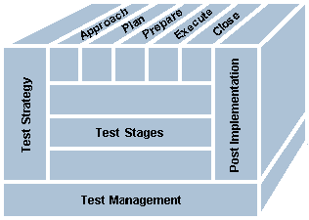
Testing Framework (3/3)
Define the Approach
Develop test approach. Use the Testing Strategy as a starting point. Outline the objectives, scope, entry/exit criteria, test tools, and test environment for the test stage. The deliverable is the Test Approach document.
Plan the Test
Create test plan. Identify test scenarios and conditions, and define test cycles for the test stage. The deliverables include Test Scenarios, Test Conditions and Expected Results, and Test Cycle Control Sheet within the Test Plan composite.
Plan test environment. Define the test environment requirements and set-up plans.
Prepare the Test
Complete test plan. Expand the Test Plan by defining input data and refining the expected results to create the Test Script deliverable. Prepare the test cycle schedule.
Prepare test environment. Establish and prove the environment before test execution.
Execute the Test
Execute test. Execute the test scripts, compare the actual results to the expected results, and identify and resolve any discrepancies. The deliverables are documented actual results, fixed defects, and a fully executed Test Plan.
Support test environment. Ensure that the test environment is effectively supported.
Close the Test
Sign-off. Complete the test stage in line with requirements. Ensure that all exit criteria are met and all deliverables are accounted for. The deliverables are the Test Closure Memo and a sign-off sheet.

Slide 17
Definitions
  Errors
  These are problems found in the stage where they were created.
  Defects
These are problems found in a stage successive to the stage where they were created.
  Faults
These are problems found after implementation.
Notes:
The early development of the test plan, during the analysis or design stage, ensures that the specifications being developed are testable and that the people who best understand the specifications of the product define complete and comprehensive test conditions

Slide 18
Why do faults occur in software?
software is written by human beings
  - who know something, but not everything
  who have skills, but aren’t perfect
under increasing pressure to deliver to strict deadlines
  - no time to check but assumptions may be wrong
  - systems may be incomplete
Notes:
The early development of the test plan, during the analysis or design stage, ensures that the specifications being developed are testable and that the people who best understand the specifications of the product define complete and comprehensive test conditions

Slide 19
What do software faults cost?
huge sums
  - Legal penalties
very little or nothing at all
  - minor inconvenience , not visible
software is not “linear”:
  - small input may have very large effect
Safety Critical Systems
-radiation treatment kills patients (Therac-25)
  - bank system overdraft letters cause suicide
Notes:
The early development of the test plan, during the analysis or design stage, ensures that the specifications being developed are testable and that the people who best understand the specifications of the product define complete and comprehensive test conditions

Slide 20
Why is testing necessary
because software is likely to have faults
to learn about the reliability of the software
to fill the time between delivery of the software and the release date
to prove that the software has no faults
because testing is included in the project plan
because failures can be very expensive
to avoid being sued by customers
Notes:
The early development of the test plan, during the analysis or design stage, ensures that the specifications being developed are testable and that the people who best understand the specifications of the product define complete and comprehensive test conditions

Slide 21
So little time, so much to test ..
test time will always be limited
Need to determine:
  - what to test first
  what to test most place emphasis
  How thoroughly to test each item
  - what not to test (this time)
allocate the time available for testing by prioritising testing ...
Notes:
The early development of the test plan, during the analysis or design stage, ensures that the specifications being developed are testable and that the people who best understand the specifications of the product define complete and comprehensive test conditions

Slide 22
Most important principle
Prioritise tests
so that,
whenever you stop testing,
you have done the best testing
in the time available
Notes:
The early development of the test plan, during the analysis or design stage, ensures that the specifications being developed are testable and that the people who best understand the specifications of the product define complete and comprehensive test conditions

Slide 23
A good Test Case
effective
exemplary
evolvable
economic
Finds faults
Represents others
Easy to maintain
Cheap to use
Notes:
The early development of the test plan, during the analysis or design stage, ensures that the specifications being developed are testable and that the people who best understand the specifications of the product define complete and comprehensive test conditions

Slide 24
Tests can be conducted on the basis of
Black-box
What the program is suppose to do(requirements/specification)
Testing based on the external specifications without knowledge of how the system is constructed
White-box testing.
How the program works
Testing based on the internal specifications with knowledge of how the system is constructed

Slide 25
Comparison of Black and White box testing
Instance where white box testing is better than black box testing
Logical error
Memory overflow undetected
Typological error
Instance where black box testing is better than white box testing
Integration errors
Database errors
Performance errors
Incorrect/missing functions
Initialization/termination errors

Slide 26
The test Process
Planning
preparation
execution
reporting
check
completion

Slide 27
Test planning
how the test strategy and project test plan apply to the software under test
document any exceptions to the test strategy
  e.g. only one test case design technique needed for this functional area because it is less critical
other software needed for the tests, such as stubs and drivers, and environment details
set test completion criteria

Slide 28
Test Preparation
Planning
preparation
execution
reporting
check
completion
Identify conditions
Design test cases
Build tests

Slide 29
Test Preparation
test preparation can be broken down into three distinct tasks:
  1. identify: determine ‘what’ is to be tested (identify
  test conditions) and prioritise
  2. design: determine ‘how’ the ‘what’ is to be tested
  (i.e. design test cases)
  3. build: implement the tests (data, scripts, etc.)

Slide 30
Test Execution
Planning
preparation
execution
reporting
check
completion

Slide 31
Execution
Execute prescribed test cases
  most important ones first
  would not execute all test cases if
    testing only fault fixes
    too many faults found by early test cases
    time pressure
  can be performed manually or automated

Slide 32
Test Reporting
Planning
preparation
execution
reporting
check
completion

Slide 33
Test Reporting
The test report contains:
  identities and versions (unambiguously) of
    software under test
    test specifications
Compare actual outcome with expected outcome. Log discrepancies accordingly:
  software fault
  test fault (e.g. expected results wrong)
  environment or version fault
  test run incorrectly

Slide 34
Test Reporting
Log coverage levels achieved (for measures specified as test completion criteria)
After the fault has been fixed, repeat the required test activities (execute, design, plan)

Slide 35
Test Completion
Planning
preparation
execution
reporting
check
completion

Slide 36
Test Completion
Check test completion
  Test completion criteria were specified in the test plan
  If not met, need to repeat test activities, e.g. test specification to design more tests
Coverage too low
preparation
execution
reporting
check
completion
Coverage
OK

Slide 37
Completion criteria
Completion or exit criteria apply to all levels of testing - to determine when to stop
  coverage, using a measurement technique, e.g.
    branch coverage for unit testing
    user requirements
    most frequently used transactions
  faults found (e.g. versus expected)
  cost or time

Slide 38
Types of Testing
Types of Testing
1 Principles
2 Testing Type
3 Static testing
4 Dynamic test
techniques
5 Automation
6 Tools
Notes:
The early development of the test plan, during the analysis or design stage, ensures that the specifications being developed are testable and that the people who best understand the specifications of the product define complete and comprehensive test conditions

Slide 39
Testing Types
  Contents
  Component Testing
  Assembly Testing
  Product Testing
  User Acceptance Testing
1
2
3
4
5
6
Notes:
The early development of the test plan, during the analysis or design stage, ensures that the specifications being developed are testable and that the people who best understand the specifications of the product define complete and comprehensive test conditions

Slide 40
Component testing
lowest level
tested in isolation
most thorough look at detail
  - error handling
  - interfaces
usually done by programmer
also known as unit, module, program testing
Notes:
The early development of the test plan, during the analysis or design stage, ensures that the specifications being developed are testable and that the people who best understand the specifications of the product define complete and comprehensive test conditions

Slide 41
Assembly testing
more than one (tested) component
communication between components
what the set can perform that is not possible individually
non-functional aspects if possible
integration strategy: big-bang vs incremental (top-down & bottom-up)
Mostly done by independent testers
Sometimes also called Integration testing.
Notes:
The early development of the test plan, during the analysis or design stage, ensures that the specifications being developed are testable and that the people who best understand the specifications of the product define complete and comprehensive test conditions

Slide 42
Assembly Testing - Big Bang Integration
In theory:
-if we have already tested components why not just combine them all at once? Wouldn’t this save time?
-(based on false assumption of no faults)
In practice:
  -takes longer to locate and fix faults
  -re-testing after fixes more extensive
  -end result? takes more time
Notes:
The early development of the test plan, during the analysis or design stage, ensures that the specifications being developed are testable and that the people who best understand the specifications of the product define complete and comprehensive test conditions

Slide 43
Assembly Testing - Incremental Integration
Baseline 0: tested component
Baseline 1: two components
Baseline 2: three components, etc.
Advantages:
  -easier fault location and fix
  -easier recovery from disaster / problems
  -add to tested baseline
Notes:
The early development of the test plan, during the analysis or design stage, ensures that the specifications being developed are testable and that the people who best understand the specifications of the product define complete and comprehensive test conditions

Slide 44
Product Testing
last integration step
functional
  -functional requirements and requirements
  based testing
  -business process-based testing
non-functional
  -as important as functional requirements
  -must be tested
often done by independent test group
Also called System test.
Notes:
The early development of the test plan, during the analysis or design stage, ensures that the specifications being developed are testable and that the people who best understand the specifications of the product define complete and comprehensive test conditions

Slide 45
Product Testing
Requirements-based testing
Uses specification of requirements as the basis for identifying tests
  -table of contents of the requirements spec provides an initial test inventory of test conditions
  -for each section / paragraph / topic / functional area,
    risk analysis to identify most important / critical
    decide how deeply to test each functional area
Notes:
The early development of the test plan, during the analysis or design stage, ensures that the specifications being developed are testable and that the people who best understand the specifications of the product define complete and comprehensive test conditions

Slide 46
Product Testing
Business process-based testing
Expected user profiles
  -what will be used most often?
  -what is critical to the business?
Business scenarios
  -typical business transactions (catalog to purchase)
Use cases
  -prepared cases based on real situations
Notes:
The early development of the test plan, during the analysis or design stage, ensures that the specifications being developed are testable and that the people who best understand the specifications of the product define complete and comprehensive test conditions

Slide 47
Product Testing
Non-functional Product testing
different types of non-functional system tests:
  -usability -configuration / installation
  -security -documentation
  -back-up / recovery
  -performance test
Notes:
The early development of the test plan, during the analysis or design stage, ensures that the specifications being developed are testable and that the people who best understand the specifications of the product define complete and comprehensive test conditions

Slide 48
User Acceptance testing
Final stage of validation
  -customer (user) should perform or be closely involved
  -customer can perform any test they wish, usually based on their business processes
  -final user sign-off
Approach
  -mixture of scripted and unscripted testing
Notes:
The early development of the test plan, during the analysis or design stage, ensures that the specifications being developed are testable and that the people who best understand the specifications of the product define complete and comprehensive test conditions

Slide 49
Types of Testing
Static Testing
1 Principles
2 Testing Type
3 Static testing
4 Dynamic test
techniques
5 Automation
6 Tools
Notes:
The early development of the test plan, during the analysis or design stage, ensures that the specifications being developed are testable and that the people who best understand the specifications of the product define complete and comprehensive test conditions

Slide 50
Static Testing
Contents
Static Analysis
1
2
3
4
5
6
Notes:
The early development of the test plan, during the analysis or design stage, ensures that the specifications being developed are testable and that the people who best understand the specifications of the product define complete and comprehensive test conditions

Slide 51
What can static analysis do?
A form of automated testing
  - check for violations of standards
  - check for things which may be a fault
Descended from compiler technology
  - a compiler statically analyses code, and “knows” a lot about it, e.g. variable usage; finds syntax faults
  - static analysis tools extend this knowledge
  - can find unreachable code, undeclared variables, parameter type mis-matches, uncalled functions & procedures, array bound violations, etc.
Notes:
The early development of the test plan, during the analysis or design stage, ensures that the specifications being developed are testable and that the people who best understand the specifications of the product define complete and comprehensive test conditions

Slide 52
Static Analysis
Data flow analysis
This is the study of program variables
n := 0
read (x)
n := 1
while x > y do
begin
Z := 0
read (y)
write( n*y)
x := x - n
end
Data flow anomaly: n is
re-defined without being used
Data flow anomaly: Z is
defined without being used
Notes:
The early development of the test plan, during the analysis or design stage, ensures that the specifications being developed are testable and that the people who best understand the specifications of the product define complete and comprehensive test conditions

Slide 53
Static Analysis
Control flow analysis
Highlights:
  nodes not accessible from start node
  infinite loops
  multiple entry to loops
  whether code is well structured
  whether code conforms to a flowchart grammar
  any jumps to undefined labels
  any labels not jumped to
  cyclomatic complexity and other metrics
Notes:
The early development of the test plan, during the analysis or design stage, ensures that the specifications being developed are testable and that the people who best understand the specifications of the product define complete and comprehensive test conditions

Slide 54
Static Analysis
Unreachable code example
Macro definitions
Buffsize: 1000
Mailboxmax: 1000
IF Buffsize < Mailboxmax THEN
Error-Exit
ENDIF
Static Analysis finds the THEN clause unreachable, so will flag a fault
Notes:
The early development of the test plan, during the analysis or design stage, ensures that the specifications being developed are testable and that the people who best understand the specifications of the product define complete and comprehensive test conditions

Slide 55
Cyclomatic complexity
cyclomatic complexity is a measure of the complexity of a flow graph (METRICS)
  -(and therefore the code that the flow graph represents)
the more complex the flow graph, the greater the measure
it can most easily be calculated as:
  -complexity = number of decisions + 1
Other Metrics - LOC - fan-in, fan-out - Nesting levels
Notes:
The early development of the test plan, during the analysis or design stage, ensures that the specifications being developed are testable and that the people who best understand the specifications of the product define complete and comprehensive test conditions

Slide 56
Which flow graph is most complex?
What is the cyclomatic complexity?
1
2
5
3
Notes:
The early development of the test plan, during the analysis or design stage, ensures that the specifications being developed are testable and that the people who best understand the specifications of the product define complete and comprehensive test conditions

Slide 57
Limitations and advantages
Limitations:
  cannot distinguish "fail-safe" code from programming faults or anomalies
  does not execute the code, so not related to operating conditions
Advantages:
  - can find faults difficult to "see"
  - gives objective quality assessment of code
Notes:
The early development of the test plan, during the analysis or design stage, ensures that the specifications being developed are testable and that the people who best understand the specifications of the product define complete and comprehensive test conditions

Slide 58
Dynamic Testing
1 Principles
2 Testing Type
3 Static testing
4 Dynamic test
techniques
5 Automation
6 Tools
Dynamic Test Techniques
Notes:
The early development of the test plan, during the analysis or design stage, ensures that the specifications being developed are testable and that the people who best understand the specifications of the product define complete and comprehensive test conditions

Slide 59
Dynamic Testing
Contents
What is a testing Technique
Black Box and White box Testing
Black Box Test Techniques
White Box Test Techniques
Error Guessing
1
2
3
4
5
6
Notes:
The early development of the test plan, during the analysis or design stage, ensures that the specifications being developed are testable and that the people who best understand the specifications of the product define complete and comprehensive test conditions

Slide 60
The need for techniques
Exhaustive testing (use of all possible inputs and conditions) is impossible
  - must use a subset of all possible test cases
  - must have high probability of detecting faults
Need thought processes that help us select test cases more intelligently
  -test case design techniques are such thought processes
Notes:
The early development of the test plan, during the analysis or design stage, ensures that the specifications being developed are testable and that the people who best understand the specifications of the product define complete and comprehensive test conditions

Slide 61
What is a testing technique?
a procedure for selecting or designing tests
based on a structural or functional model of the software
successful at finding faults
a way of deriving good test cases
Testing should be rigorous, thorough and systematic
Notes:
The early development of the test plan, during the analysis or design stage, ensures that the specifications being developed are testable and that the people who best understand the specifications of the product define complete and comprehensive test conditions

Slide 62
Advantages of techniques
Different people: similar probability find faults
  - gain some independence of thought
Effective testing: more faults with less effort
  - focus attention on specific types of fault
  - know you're testing the right thing
Efficient use of time:
  - avoid duplication
  - systematic techniques are measurable
Using techniques makes testing much more effective
Notes:
The early development of the test plan, during the analysis or design stage, ensures that the specifications being developed are testable and that the people who best understand the specifications of the product define complete and comprehensive test conditions

Slide 63

Three types of systematic technique
Static (non-execution)
  examination of documentation,
  source code listings, etc.
Functional (Black Box)
  based on behaviour /
  functionality of software
Structural (White Box)
  based on structure
  of software
Notes:
The early development of the test plan, during the analysis or design stage, ensures that the specifications being developed are testable and that the people who best understand the specifications of the product define complete and comprehensive test conditions

Slide 64
Black box versus white box?
Black box appropriate
at all levels but
dominates higher
levels of testing
White box used
predominately
at lower levels
to compliment
black box
Accept. Test
System Test
Integration T
Component T
Notes:
The early development of the test plan, during the analysis or design stage, ensures that the specifications being developed are testable and that the people who best understand the specifications of the product define complete and comprehensive test conditions

Slide 65
Black Box Test Techniques
  Specification derived tests
  Equivalence partitioning
  Boundary value analysis
  Decision Tables
  Cause-effect graphing
Notes:
The early development of the test plan, during the analysis or design stage, ensures that the specifications being developed are testable and that the people who best understand the specifications of the product define complete and comprehensive test conditions

Slide 66
Specification derived tests (1/2)
Consider the specification for a function to calculate the square root of a real number:
  Input - real number
  Output - real number
  When given an input of zero or greater, the positive square root of the input shall be returned.
  When given an input of less than 0, the error message "Square root error - negative input" shall be displayed and a value of 0 returned.
  The library routine Print_Line shall be used to display the error message.

Slide 67
Specification derived tests (2/2)
There are three statements in this specification, which can be addressed by two test cases
Print_Line conveys structural information in the specification
  Test Case 1: Input 4, Return 2
    Exercises the first statement in the specification
    ("When given an input of 0 or greater, the positive square root of the input shall be returned.").
  Test Case 2: Input -10, Return 0, Output "Square root error - illegal negative input" using Print_Line
    Exercises the second and third statements in the specification
    ("When given an input of less than 0, the error message "Square root error - illegal negative input" shall be displayed and a value of 0 returned. The library routine Print_Line shall be used to display the error message.").

Slide 68
Equivalence partitioning (EP)
divide (partition) the inputs, outputs, etc. into areas which are the same (equivalent)
assumption: if one value works, all will work
one from each partition better than all from one
0
1
100
101
Notes:
The early development of the test plan, during the analysis or design stage, ensures that the specifications being developed are testable and that the people who best understand the specifications of the product define complete and comprehensive test conditions

Slide 69
Boundary value analysis (BVA)
faults tend to lurk near boundaries
good place to look for faults
test values on both sides of boundaries
0
1
100
101
Notes:
The early development of the test plan, during the analysis or design stage, ensures that the specifications being developed are testable and that the people who best understand the specifications of the product define complete and comprehensive test conditions

Slide 70
Example: Loan application
Customer Name
Account number
Loan amount requested
Term of loan
Monthly repayment
Term:
Repayment:
Interest rate:
Total paid back:
2-64 chars.
6 digits, 1st
non-zero
$500 to $9000
1 to 30 years
Minimum $10
Notes:
The early development of the test plan, during the analysis or design stage, ensures that the specifications being developed are testable and that the people who best understand the specifications of the product define complete and comprehensive test conditions

Slide 71
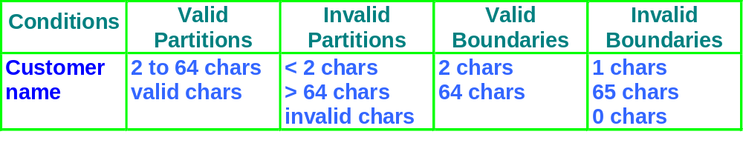
Customer Name
Number of characters:
1
2
64
65
invalid
valid
invalid
Valid characters:
A-Z
Any
other
-_’
a-z
Notes:
The early development of the test plan, during the analysis or design stage, ensures that the specifications being developed are testable and that the people who best understand the specifications of the product define complete and comprehensive test conditions

Slide 72
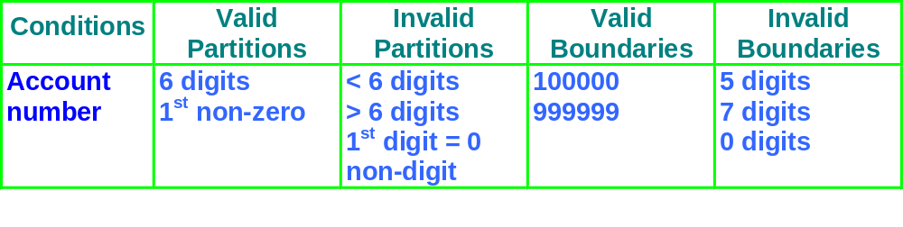
Account Number
valid: non-zero
first character:
invalid: zero
number of digits:
5
6
7
invalid
invalid
valid
Notes:
The early development of the test plan, during the analysis or design stage, ensures that the specifications being developed are testable and that the people who best understand the specifications of the product define complete and comprehensive test conditions

Slide 73
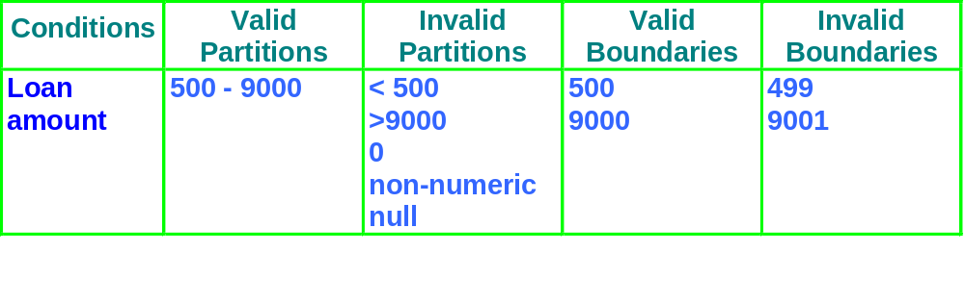
Loan Amount
499
500
9000
9001
invalid
valid
invalid
Notes:
The early development of the test plan, during the analysis or design stage, ensures that the specifications being developed are testable and that the people who best understand the specifications of the product define complete and comprehensive test conditions

Slide 74
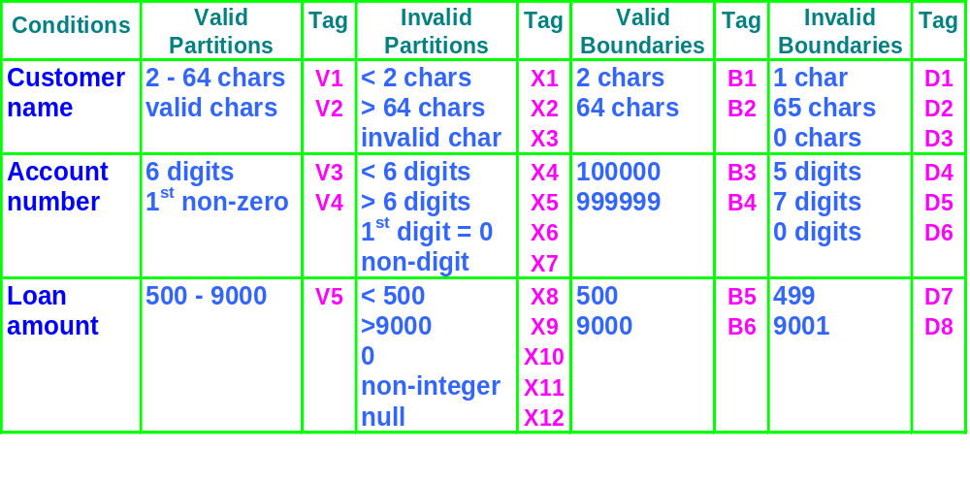
Condition template
Notes:
The early development of the test plan, during the analysis or design stage, ensures that the specifications being developed are testable and that the people who best understand the specifications of the product define complete and comprehensive test conditions

Slide 75
Design test cases
Test
Description
Expected Outcome
New Tags
Case
Covered
1
Name: John Smith
Acc no: 123456
Loan: 2500
Term: 3 years
Term: 3 years
Repayment: 79.86
Interest rate: 10%
Total paid: 2874.96
V1, V2,
V3, V4,
V5 .....
2
Name: AB
Acc no: 100000
Loan: 500
Term: 1 year
Term: 1 year
Repayment: 44.80
Interest rate: 7.5%
Total paid: 537.60
B1, B3,
B5, .....
Notes:
The early development of the test plan, during the analysis or design stage, ensures that the specifications being developed are testable and that the people who best understand the specifications of the product define complete and comprehensive test conditions

Slide 76
Consider, testing a procedure called
Validate_New_Password that accepts a password from user and validates that the new password conforms to the following rules
1. A password must be between 6-10, characters.
2. The first and the last character must be alphabetic, numeric, or ?
3. The remaining characters may be any character except control characters.
4. The password must not be in a dictionary.

Slide 77
Equivalence Partitions
Length First Character Last Character
(v)1. 6-10 (v) 2. alphabetic (v) 5. alphabetic
(v)10. <6 (v) 3. numeric (v) 6. numeric
(inv) 11. >10 4. ? (v) 7. ?
12. control (inv) 14. control
13. other (inv) 15. other
Remaining Character Password Status
8. normal 9. not in dictionary
(inv) 16. Control (inv) 17. in dictionary

Slide 78
Decision tables
explore combinations of inputs, situations or events,
it is very easy to overlook specific combinations of input
start by expressing the input conditions of interest so that they are either TRUE or FALSE
  record found
  file exists
  code valid
  policy expired
  account in credit
  due date > current date
Notes:
The early development of the test plan, during the analysis or design stage, ensures that the specifications being developed are testable and that the people who best understand the specifications of the product define complete and comprehensive test conditions

Slide 79
Example: student access
A university computer system allows students an allocation of disc space depending on their projects.
If they have used all their allotted space, they are only allowed restricted access, i.e. to delete files, not to create them. This is assuming they have logged on with a valid username and password.
What are the input and output conditions?
Notes:
The early development of the test plan, during the analysis or design stage, ensures that the specifications being developed are testable and that the people who best understand the specifications of the product define complete and comprehensive test conditions

Slide 80
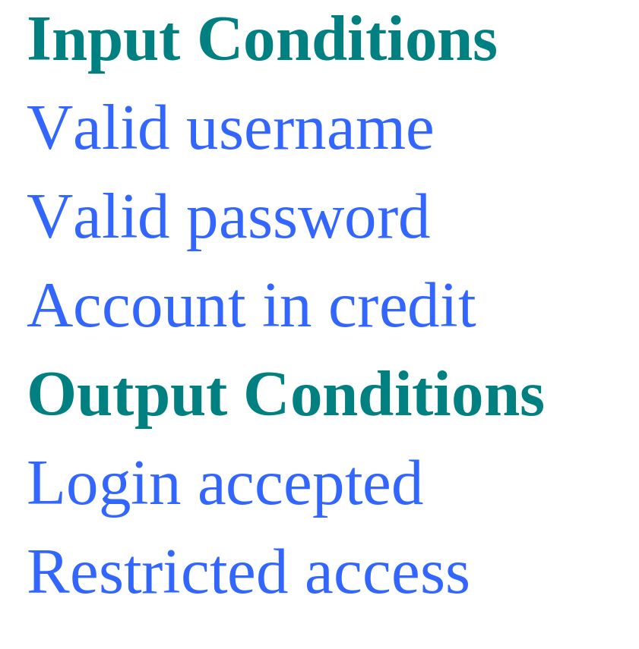
List the input and output conditions
list the ‘input conditions’ in the first column of the table
list the ‘output conditions’ under the input conditions
Notes:
The early development of the test plan, during the analysis or design stage, ensures that the specifications being developed are testable and that the people who best understand the specifications of the product define complete and comprehensive test conditions

Slide 81
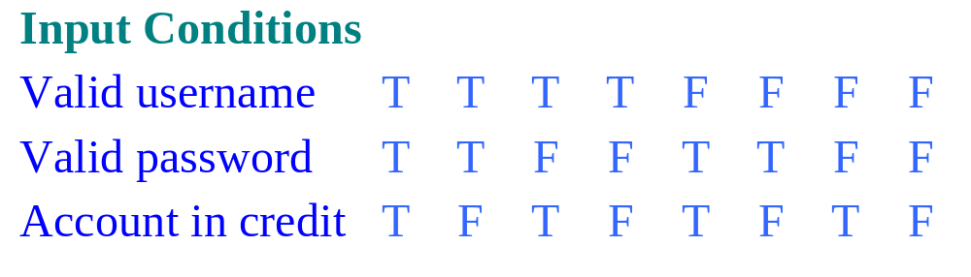
Determine input combinations
add columns to the table for each unique combination of input conditions.
each entry in the table may be either ‘T’ for true, ‘F’ for false.
Notes:
The early development of the test plan, during the analysis or design stage, ensures that the specifications being developed are testable and that the people who best understand the specifications of the product define complete and comprehensive test conditions

Slide 82
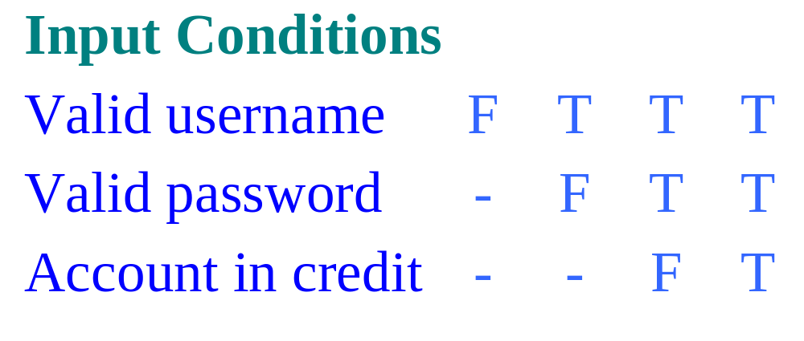
Rationalise input combinations
some combinations may be impossible or not of interest
some combinations may be ‘equivalent’
use a hyphen to denote “don’t care”
Notes:
The early development of the test plan, during the analysis or design stage, ensures that the specifications being developed are testable and that the people who best understand the specifications of the product define complete and comprehensive test conditions

Slide 83
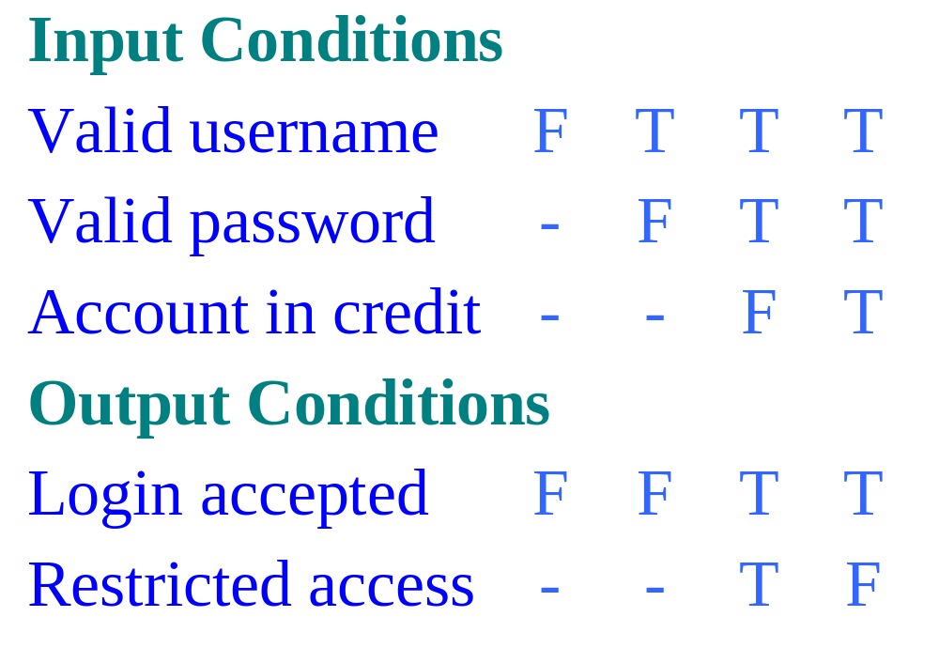
Complete the table
determine the expected output conditions for each combination of input conditions
Notes:
The early development of the test plan, during the analysis or design stage, ensures that the specifications being developed are testable and that the people who best understand the specifications of the product define complete and comprehensive test conditions

Slide 84
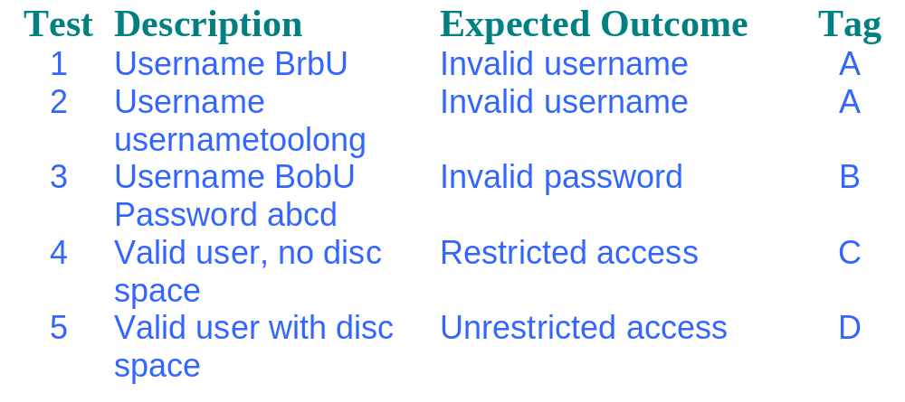
Design test cases
usually one test case for each column
Notes:
The early development of the test plan, during the analysis or design stage, ensures that the specifications being developed are testable and that the people who best understand the specifications of the product define complete and comprehensive test conditions

Slide 85
White Box Test Techniques
  Statement testing
  Branch / Decision testing
  “They are most often used to measure "coverage” how
  much of the structure has been exercised or covered by
  a set of tests.”
Notes:
The early development of the test plan, during the analysis or design stage, ensures that the specifications being developed are testable and that the people who best understand the specifications of the product define complete and comprehensive test conditions

Slide 86
The test coverage
Function exercised,
insufficient structure
better testing
Functional
testedness
Structure exercised,
insufficient function
% Statement % Decision % Condition
Combination
Structural testedness
Notes:
The early development of the test plan, during the analysis or design stage, ensures that the specifications being developed are testable and that the people who best understand the specifications of the product define complete and comprehensive test conditions

Slide 87
Statement coverage
percentage of executable statements
exercised by a test suite
  number of statements exercised
  total number of statements
example:
  - program has 100 statements
  - tests exercise 87 statements
  - statement coverage = 87%
normally measured
by a software tool.
=
Typical ad hoc testing achieves 60 - 75%
Notes:
The early development of the test plan, during the analysis or design stage, ensures that the specifications being developed are testable and that the people who best understand the specifications of the product define complete and comprehensive test conditions

Slide 88
Example of statement coverage
Test
case
Input
Expected
output
1
2
3
4
5
read(a)
IF a > 6 THEN
b = a
ENDIF
print b
1
7
7
As all 5 statements are ‘covered’ by
this test case, we have achieved
100% statement coverage
Statement
numbers
Notes:
The early development of the test plan, during the analysis or design stage, ensures that the specifications being developed are testable and that the people who best understand the specifications of the product define complete and comprehensive test conditions

Slide 89
Decision coverage
(Branch coverage)
percentage of decision outcomes
exercised by a test suite
  number of decisions outcomes exercised
  total number of decision outcomes
example:
  - program has 120 decision outcomes
  - tests exercise 60 decision outcomes
  - decision coverage = 50%
=
Typical ad hoc testing achieves 40 - 60%
Notes:
The early development of the test plan, during the analysis or design stage, ensures that the specifications being developed are testable and that the people who best understand the specifications of the product define complete and comprehensive test conditions

Slide 90
Example 1
Read A
IF A > 0 THEN
IF A = 21 THEN
Print “Key”
ENDIF
Print “Key1”
ENDIF
Read
A>0
Yes
A=21
Yes
No
No
Print
  Cyclomatic Complexity:_____
  Minimum tests to achieve: Statement coverage: ______ Branch coverage: _____
3
End
1
3
Notes:
The early development of the test plan, during the analysis or design stage, ensures that the specifications being developed are testable and that the people who best understand the specifications of the product define complete and comprehensive test conditions

Slide 91
Example 2
Read
Read A
Read B
IF A > 0 THEN
IF B = 0 THEN
Print “No values”
ELSE
Print B
IF A > 21 THEN
Print A
ENDIF
ENDIF
ENDIF
A>0
Yes
B=0
No
Print
No
Yes
A=21
Yes
Print
Print
No
End
  Cyclomatic complexity: _____ Minimum tests to achieve: Statement coverage: ______ Branch coverage: _____
4
2
4
Notes:
The early development of the test plan, during the analysis or design stage, ensures that the specifications being developed are testable and that the people who best understand the specifications of the product define complete and comprehensive test conditions

Slide 92
Non-systematic test techniques
Error Guessing is
  - always worth including
  - after systematic techniques have been used
  - can find some faults that systematic techniques can miss
- Trial and error / Ad hoc - Error guessing / Experience-driven - Unscripted Testing
Not a good approach to start testing with
Notes:
The early development of the test plan, during the analysis or design stage, ensures that the specifications being developed are testable and that the people who best understand the specifications of the product define complete and comprehensive test conditions

Slide 93
Dynamic Testing
1 Principles
2 Testing Type
3 Static testing
4 Dynamic test
techniques
5 Automation
6 Tools
Automation
Notes:
The early development of the test plan, during the analysis or design stage, ensures that the specifications being developed are testable and that the people who best understand the specifications of the product define complete and comprehensive test conditions

Slide 94
Governs the
quality of tests
Planning
Intellectual
one-off
activity
Preparation
Good to
automate
activity
repeated
many times
Execute
Clerical
Reporting
Notes:
The early development of the test plan, during the analysis or design stage, ensures that the specifications being developed are testable and that the people who best understand the specifications of the product define complete and comprehensive test conditions

Slide 95
Tests to automate
run many times
  - regression tests
  - mundane
expensive to perform manually
  - time consuming and necessary
  - multi-user tests, endurance/reliability tests
difficult to perform manually
  - timing critical
  - complex / intricate
Automate
Notes:
The early development of the test plan, during the analysis or design stage, ensures that the specifications being developed are testable and that the people who best understand the specifications of the product define complete and comprehensive test conditions

Slide 96
Tests not to automate
not run often
  - one off tests (unless several iterations likely and build cost can be minimised)
not important
  - will not find serious problems
usability tests
  - do the colours look nice?
Automate
Notes:
The early development of the test plan, during the analysis or design stage, ensures that the specifications being developed are testable and that the people who best understand the specifications of the product define complete and comprehensive test conditions

Slide 97
Dynamic Testing
1 Principles
2 Testing Type
3 Static testing
4 Dynamic test
techniques
5 Automation
6 Tools
Tools Landscape
Notes:
The early development of the test plan, during the analysis or design stage, ensures that the specifications being developed are testable and that the people who best understand the specifications of the product define complete and comprehensive test conditions

Slide 98
Tools Landscape
Phases Tools Available
Requirement Requisite Pro, Calibre RM (borland), Telelogic Doors etc.
Design Rational Rose, Together, Rational XDE etc
Planning MS Project, MS Project server, Customized excel sheet etc
Build PL-SQL, TOAD(by Quest), DB Artisan(for Sybase), Erwin(DB design tool) etc
Notes:
The early development of the test plan, during the analysis or design stage, ensures that the specifications being developed are testable and that the people who best understand the specifications of the product define complete and comprehensive test conditions

Slide 99
Tools Landscape
Phases Tools Available
Static testing Checkstyle, Findbugs etc
Unit Testing JUnit(Java), JTest, XUnit etc
Functional Testing Rational Robot, WinRunner etc
Memory leakages Rational Purify, JProbe etc
Performance Testing Rational Robot, LoadRunner, OpenSTA etc
Coverage tool Rational Purecoverage, Jcoverage etc
Defect Tracking Kintana, Test Director etc
Notes:
The early development of the test plan, during the analysis or design stage, ensures that the specifications being developed are testable and that the people who best understand the specifications of the product define complete and comprehensive test conditions

Slide 100
Testing
1 Principles
2 Testing Type
3 Static testing
4 Dynamic test
techniques
5 Automation
6 Tools
Notes:
The early development of the test plan, during the analysis or design stage, ensures that the specifications being developed are testable and that the people who best understand the specifications of the product define complete and comprehensive test conditions

